Slide 2
Sustainability Starts at the Molecule
We drive policy outcomes for Sustainable Fuels, Chemicals and Materials by shaping international commitments, advocating for standardized market rules and building consensus across borders and industries.

Slide 3


Workstreams
Intergovernmental Commitments
Engage in global dialogues to influence the narrative surrounding sustainable fuels, chemicals, and materials (SFCM) in climate and energy policy
Represents industry to COP30, Clean Energy Ministerial, G7, G20, UNFCCC
Informed by SFCM Industry Forums and Workshops – A series of in-person discussions throughout 2025, hosted in concert with key international events
Policy Advocacy
Solve common policy issues between molecular technologies, supplementary to existing trade association, NGO, and industry advocacy efforts
Standardization of carbon accounting, procurement, and other market rules for all SFCM feedstocks, production pathways, and end-uses
Workstream-specific calls occur on a bi-monthly basis

Slide 4

Intergovernmental Commitments
Molecule Group facilitates intergovernmental commitments for sustainable molecules with input from the Executive Policy Committee and Regional Forums.
In 2025, we are working with the government of Brazil in its role as COP30 President to secure a COP30 commitment. An aspirational goal is expected to consist of the following components:
  Total emissions reduction ambition, e.g., reduce emissions from FCM by X Gigatonnes by Y date.
  Carbon Intensity reduction target for each fuel modality.
  Financing target to kickstart the sector.
  Innovation targets to bring about needed technology development/improvement.

Slide 5
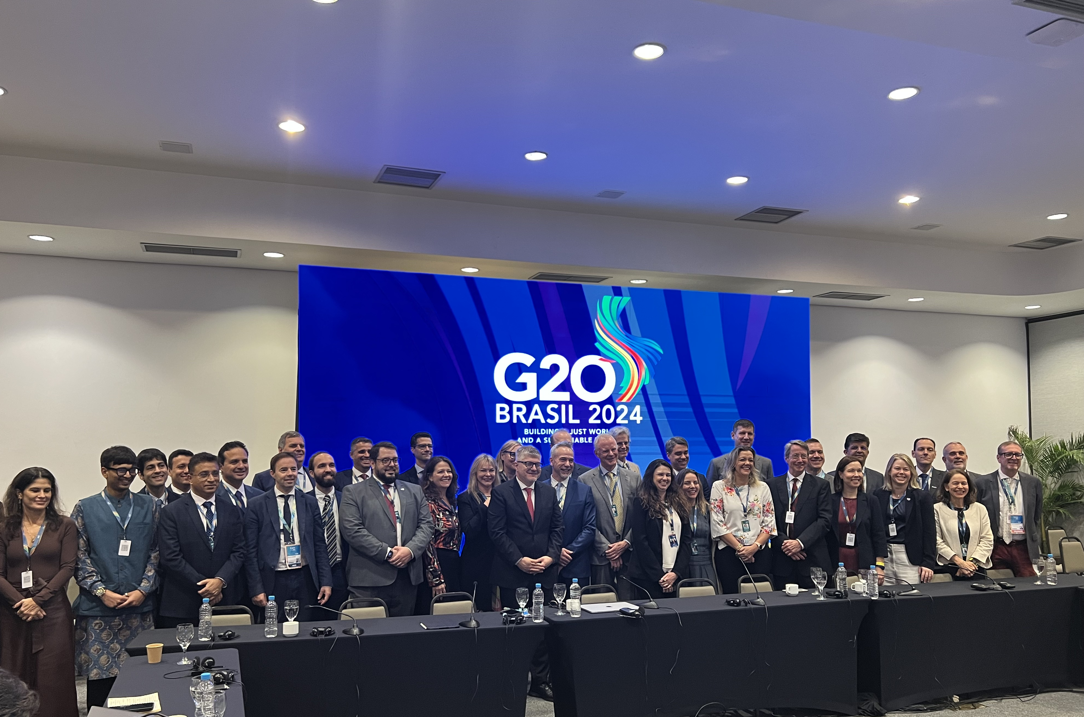
Policy Advocacy Working Group
Molecule Group’s Policy Advocacy Working Group brings together representatives of SFCM technologies to solve common policy issues.
In 2025, we are focused on developing consistency among carbon accounting and procurement frameworks, including for voluntary markets and international venues.
Participants in monthly meetings include:
  Executive Policy Committee (EPC) members
  Regional Co-Chairs
  Workshop Co-Chairs
Policy Briefing with a broader group of stakeholder, including Forum & Workshop Delegates are held quarterly.

Slide 6

Executive Policy Committee
Molecule Group’s Executive Policy Committee guides policy advocacy and Forum conversations.
The EPC represents the full spectrum of sustainable fuels, chemicals, and materials production technologies and end uses.
  Invitation-only
  8 trade association and/or NGO representatives
  8 industry representatives
The EPC co-chairs all SFCM Regional Forums & Workshops, participates in monthly EPC-only meetings, and receives full access to prep calls and bi-monthly policy advocacy, intergovernmental commitment, and Biofuture Council meetings.

Slide 7

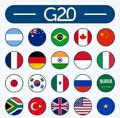





Connecting Industry & Building Consensus
Molecule Group builds connective tissue between Bio-based, Synthetic, and Hydrogen-based Fuels, Chemicals and Materials. We create consensus across borders and industries with a “rising tide lifts all boats” approach, connecting Industry Leaders to Energy Transition Leaders and International Processes to drive meaningful policy action.
Industry Leaders
Energy Transition Leaders
International Processes
Biofuels
CCS
E-fuels
H2
CEM FUTURE FUELS

Slide 8
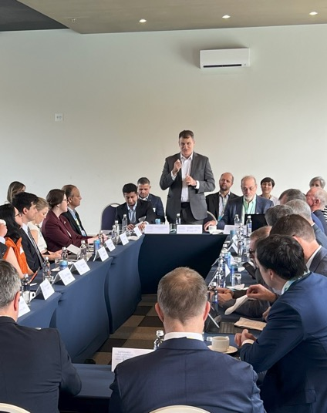
2025 Forums & Workshops
Molecule Group aggregates and synthesizes industry contributions for COP30 and liaises with the Brazilian Presidency to develop a global Sustainable Fuels, Chemicals and Materials Target.
Molecule Group enables Industry contributions by hosting Regional Workshops and Forums to enable cross-sectoral dialog.
Regional Forums are held alongside top-tier international events:
  Africa | South Africa is hosting the G20
  Asia | South Korea is hosting APEC and the Clean Energy Ministerial
  Europe | Europe continues to drive the global policy agenda
  North America | Canada is hosting the G7
  South America | Brazil is hosting COP30

Slide 9






2025 Forums & Workshops: Calendar
Forums & Workshops
  Inform intergovernmental commitments and policy advocacy
  Draw perspectives from across world regions, technologies and organization types
Co-Chair, Delegate, and Observer roles are available to Forum Sponsors
Series Sponsors are given Co-Chair and Delegate roles for all events
AFRICA Forum G20 South Africa
ASIA Forum CEM16/APEC South Korea
CEM16 Prep South Korea
BRAZIL Forum COP30 Brazil
CANADA Forum G7
EU Forum
ABLC & Clean Fuels Canada
India Energy Week
IEA Workshop
USA Forum
February
March
TBC
April
April
June
June
August
September
November

Slide 10
2025 Forums & Workshops: Regions
Q1
Q2
Q3
Q4
Africa
S. Africa G20
G20 Prep Workshop
Asia
S. Korea CEM16
India Energy Week & Australia RFW
CEM16-APEC FORUM Korea
Europe
Workshops, including IEA
Brussels FORUM
North America
Canada G7
ABLC & Clean Fuels Canada Workshops
Workshop DC
South America
Brazil COP30
TBD
COP30
CEM16 Prep Workshop Korea
G20 Energy Ministerial FORUM
Osaka Expo Workshop
TBD
Climate Week NYC FORUM
TBD
TBD
G20 Prep Workshop

Slide 11
Engagement Opportunities
Executive Policy Committee (EPC)
  Steering board for Molecule Group workstreams
  Co-Chair entire SFCM Forum & Workshop series
  Closed EPC meetings occur monthly, Forum Prep Calls prior to each event, monthly Policy Working Group meetings, quarterly Biofuture Council meetings
Forum & Workshop Co-Chairs
  Participate in Molecule Group workstreams
  Co-Chair region-specific Forums & Workshops
  Forum Prep Calls occur prior to each event, monthly Policy Working Group meetings, Biofuture Council meetings quarterly
Forum & Workshop Participation
  Contribute to specific SCFM Forums & Workshops
  Sponsor, Co-Chair, Delegate, and Observer roles available
  In-person dialogue will inform intergovernmental commitments and policy priorities
Biofuels
CCS
E-fuels
H2

Slide 12
Sponsorship Table
 | Executive Policy Committee | Regional Co-Chair | Roundtable Co-Chair | Forum Delegate | Workshop Delegate
EPC Meetings | Participate in monthly EPC-only online meetings.
Policy Advocacy Working Group | Participate in a monthly policy advocacy online meetings. Guide Policy Advocacy Working Group topics & messaging. | Participate in a monthly policy advocacy online meetings. | Participate in a monthly policy advocacy online meetings.
Forum / Workshop Leadership | Co-Chair Forums, Workshops and Invitation-Only Events for all five (5) global regions. | Co-Chair Workshops, Forums and Invitation-Only Policy Dialogs for one (1) global region. | Co-Chair one (1) Forum Roundtable for one (1) global region. | Participate in the Forum for one (1) global region. | Participate in one(1) Workshop Forum for one (1) global region.
Forum / Workshop Participation | Unlimited participation in Forums and Workshops. | Five (5) participants per Forum or Workshop. | Three (3) participants per Forum. | One (1) participant per Forum. | One (1) participant per Workshop.
Sponsorship Fee | USD 90K | USD 30K | USD 10K | USD 750. | USD 500.
Biofuture Council | Invited to join Biofuture Council Industry Advisory Board (USD 10K value) | Invited to join the Biofuture Council (USD 5K value)

